Slide 1


CS 1371 Computing for Engineers
Programming in Matlab Environment
Dr. Mary Hudachek-Buswell

Slide 2
Stacks, queues, and graphs Chapter 17

Slide 3
Stacks and Queues
Fundamental data types.
Value: collection of objects.
Operations: insert, remove, iterate, test if empty.
Intent is clear when we insert.
Which item do we remove?

Slide 4
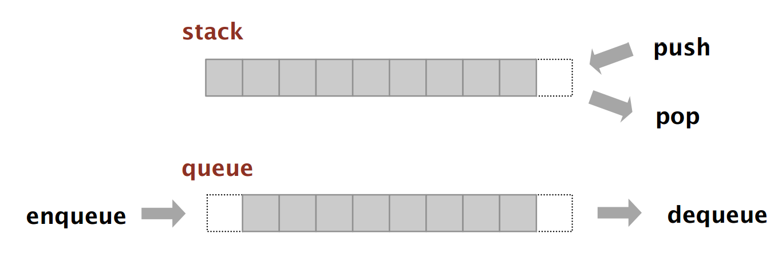
Stacks and Queues
Stack. Examine the item most recently added. LIFO = "last in first out
3 operations push, pop, top
Queue. Examine the item least recently added. FIFO = "first in first out“
2 operations enqueue, dequeue

Slide 5
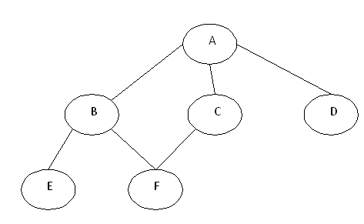
Graphs
A graph is a set of nodes or vertices and a collection of edges or arcs that each connect a pair of vertices.

Slide 6
Graph Notes
A self-loop is an edge that connects a vertex to itself.
Two edges are parallel if they connect the same pair of vertices.
When an edge connects two vertices, we say that the vertices are adjacent to one another and that the edge is incident on both vertices.
The degree of a vertex is the number of edges incident on it.
A path in a graph is a sequence of vertices connected by edges. A simple path is one with no repeated vertices.
A cycle is a path (with at least one edge) whose first and last vertices are the same. A simple cycle is a cycle with no repeated edges or vertices (except the requisite repetition of the first and last vertices).
The length of a path or a cycle is its number of edges.

Slide 7
Search Algorithms
Depth-First Search BFS -> Stack
Breadth-First Search BFS -> Queue
Dijkstra's Algorithm - Shortest path in a graph
Given two vertices, p and q determine the path with lowest length

Slide 8
Depth-First Search DFS
Problem Find a natural way to systematically visit every vertex and every edge of a graph :
Start from one vertex
Move forward all along one path (do not pass through a vertex already visited)
When stuck, turn back until you can step forward to an unvisited vertex

Slide 9
DFS Pseudo Code
dfs(v)
visit(v)
for each neighbor w of v
if w is unvisited
dfs(w)
add edge vw to tree T
end
end
end

Slide 10
DFS Example Traverse Graph G
O
stack
G
E
S
J
T
A
C
K
Output: GOJACKETS
Notes:
Start at G->O end so pop O; back to G; G->J->A->C cycle pop CA; back to J; G->J->K->E->T->S; all vertices visited so pop STEKJG
Stack GO, GJAC, GJKETS, ←----G
Output: GOJACKETS

Slide 11
Breadth-First Search BFS
Problem: It is another systematic way of visiting the vertices of a graph G. Start from a vertex, step forward all vertices adjacent to it, then step forward all vertices adjacent to its sons,...
The Breadth-First Search algorithm is quite the same algorithm as the iterative DFS, you simply replace the stack with a queue

Slide 12
BFS Pseudo Code
bfs(s)
initialize Q to be a queue with one element s
while Q not empty
take a node u from Q
if explored[u]=false then
set explored[u]= true
for each edge (u,v) adjacent to u
add v to Q
end
end
end

Slide 13
BFS Example Traverse Graph G
O
queue
G
E
S
J
T
A
C
K
Output:GOJACKETS
Notes:
Start at G->O->J end; FIFO O-> nowhere dequeue O; back to J; J->A->C->K cycle pop CA; back to J; G->J->K->E->T->S; all vertices visited so pop STEKJG
Queue OJ, J, ACK, E, TS
Output: GOJACKETS

Slide 14
Dijkstra’s Shortest Path
Problem Find the shortest path problem for weighted directional graphs:
Start from one vertex, choose stop vertex
Move forward all along shortest path (do not pass through a vertex already visited) using BFS
Keep track of the distance of the path as compared to other paths.
If you do not reach stop vertex, the path is disregarded

